Slide 1


Twitter Data Analysis with Python
Welcome to this comprehensive guide on analyzing Twitter data using Python. In this presentation, we'll explore how to authenticate with the Twitter API, collect tweets, and perform various analyses to extract meaningful insights from social media data.
We'll cover everything from setting up API authentication to creating visualizations that reveal patterns in tweet content, sentiment, and user engagement. Whether you're a data scientist, social media analyst, or Python enthusiast, these techniques will help you harness the power of Twitter data for your research or business needs.
by 6395_SHOURYADEEP MANNA

Slide 2
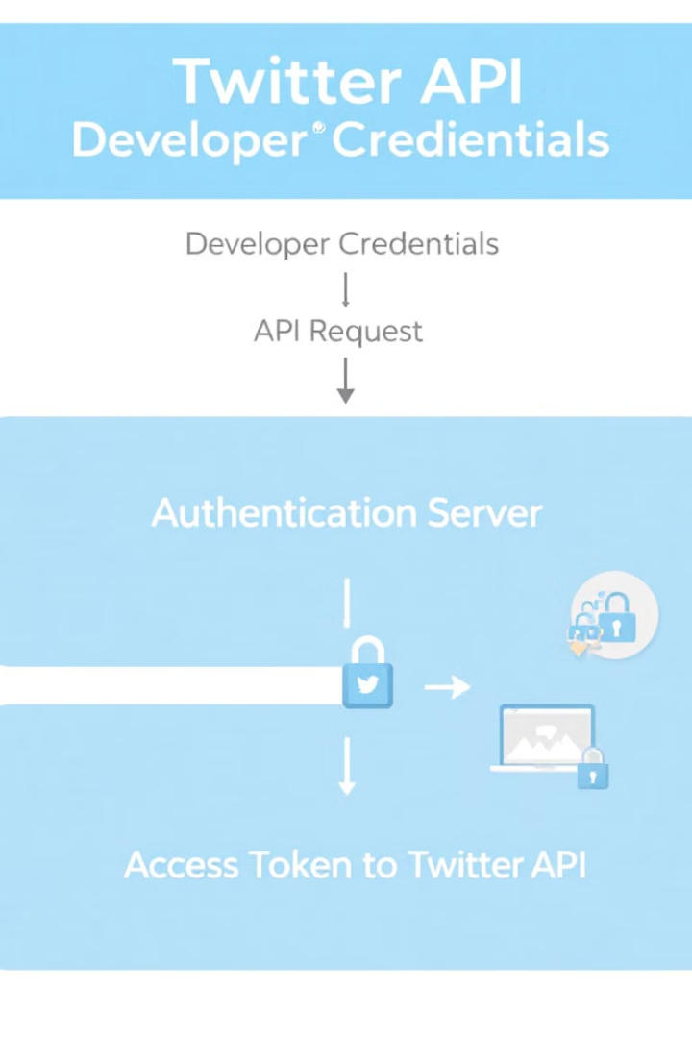
Twitter API Authentication
API Credentials
OAuth Authentication
Secure your API keys, tokens, and secrets from the Twitter Developer Portal to access the Twitter API.
Use tweepy.OAuth1UserHandler to authenticate with OAuth1 and create an API instance for making requests.
Verification
Verify credentials with api.verify_credentials() to ensure proper authentication before making API calls.
The first step in any Twitter data analysis project is authenticating with the Twitter API. This requires obtaining API credentials from the Twitter Developer Portal and using them to create an authenticated session. The code demonstrates how to use Tweepy, a popular Python library for accessing the Twitter API, to handle the authentication process.

Slide 3
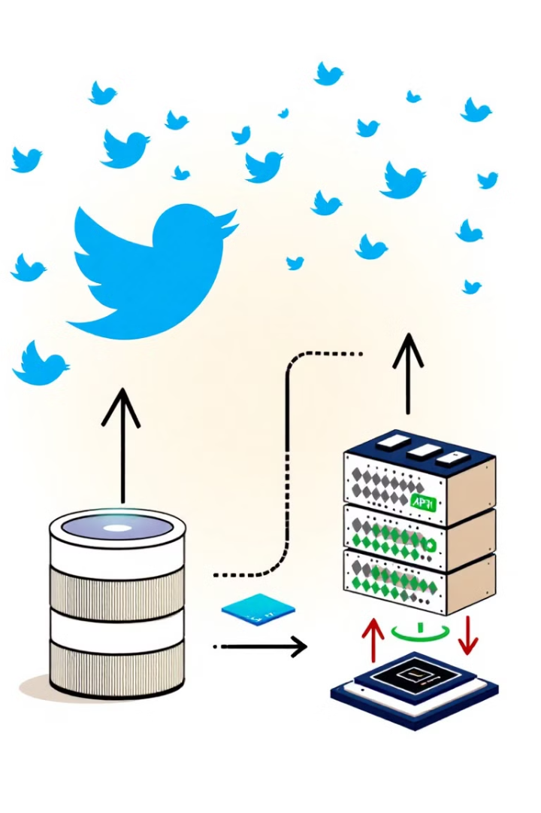




Collecting Tweets
Define Search Query
Create a specific query with hashtags, language filters, and exclusions (e.g., "#ShaheedDiwas -is:retweet lang:en")
Fetch Tweets
Use client.search_recent_tweets() with parameters for maximum results and desired tweet fields
Handle Rate Limits
Implement error handling with time.sleep() to pause when rate limits are exceeded
Store Results
Process and store the retrieved tweets for further analysis
After authentication, the next step is collecting tweets that match specific criteria. The code demonstrates how to search for recent tweets containing the hashtag "#ShaheedDiwas" while excluding retweets and filtering for English language tweets. It also shows how to handle rate limiting by implementing a waiting period when the API limit is reached.

Slide 4




Data Processing and Storage
Extract Data
Convert to DataFrame
Save to CSV
Validate Data
Pull relevant fields from tweet objects (created_at, text, author_id)
Export the DataFrame to a CSV file for persistence and future use
Check for null values and verify data integrity
Transform tweet data into a pandas DataFrame for easier manipulation
Once tweets are collected, they need to be processed and stored in a format suitable for analysis. The code shows how to extract relevant information from tweet objects, convert it to a pandas DataFrame, and save it to a CSV file. This approach provides a structured way to work with the data and enables persistence for future analysis sessions.
The example also demonstrates how to check for missing values in the dataset, which is an important step in ensuring data quality before proceeding with analysis.

Slide 5
Basic Tweet Analysis
10
0
10
Total Tweets
Unique Authors
#ShaheedDiwas
Number of tweets collected in the sample
Number of distinct users who posted tweets
Frequency of the most common hashtag
After collecting and processing the tweets, we can perform basic analysis to understand the dataset. The code calculates the total number of tweets collected, counts unique authors, and identifies the most common words used in the tweets. This provides an initial overview of the data and helps identify potential areas for deeper analysis.
In this example, we see that "#ShaheedDiwas" appears in all 10 tweets, followed by "https" (links), "Bhagat" and "Singh" (referring to the Indian revolutionary Bhagat Singh), indicating that the tweets are primarily about commemorating Martyrs' Day in India.

Slide 6
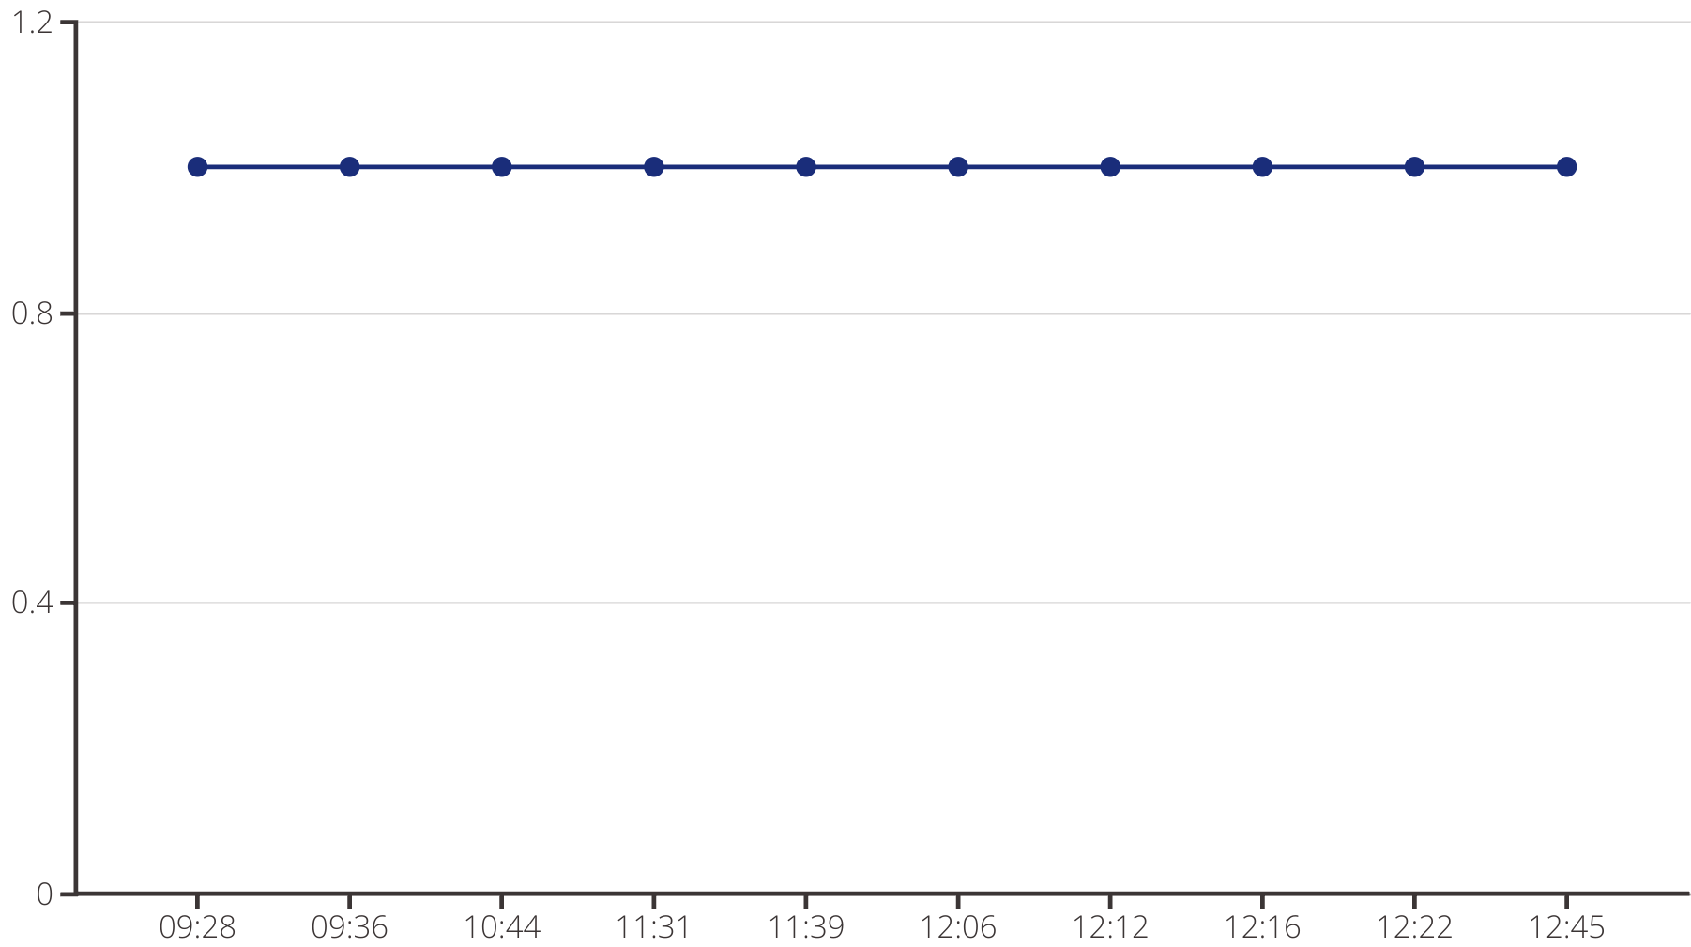
Temporal Analysis
Understanding when tweets are posted can reveal patterns in user activity and engagement. The code demonstrates how to analyze the temporal distribution of tweets by converting the 'created_at' timestamp to datetime format and resampling the data to count tweets per minute.
The resulting line chart shows the frequency of tweets over time, which can help identify peak posting times and trends in user activity. This information is valuable for social media managers planning content schedules or researchers studying communication patterns.

Slide 7
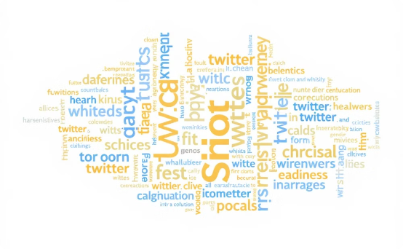
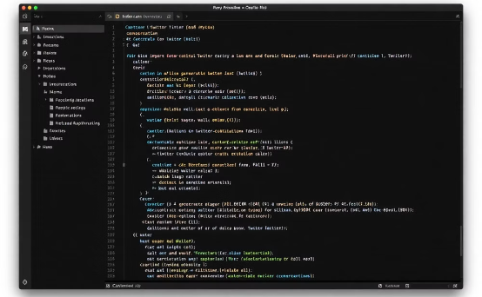
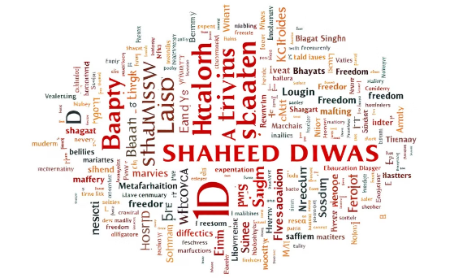
Content Analysis with Word Clouds
Word Cloud Generation
Implementation
Results
The WordCloud library creates visual representations where word size corresponds to frequency in the dataset. This provides an intuitive way to identify dominant themes and topics in the tweets.
The code demonstrates how to generate a word cloud from tweet text using just a few lines of Python. The process involves joining all tweet text and passing it to the WordCloud generator with customized parameters.
The resulting visualization highlights key terms like "ShaheedDiwas," "Bhagat," "Singh," "tribute," and other words related to commemorating Indian freedom fighters, providing immediate insight into the tweet content.
Word clouds offer a visually appealing way to understand the most common terms in a text corpus. The size of each word in the cloud represents its frequency in the dataset, making it easy to identify dominant themes and topics at a glance.

Slide 8






Sentiment Analysis
Neutral
Factual statements without emotional content
Positive
Tweets expressing admiration, gratitude, or celebration
Negative
Tweets expressing criticism, disappointment, or concern
Sentiment analysis helps understand the emotional tone of tweets. The code uses TextBlob, a simple natural language processing library, to classify tweets as positive, negative, or neutral based on their content. This classification is performed by analyzing the polarity score of each tweet, which ranges from -1 (negative) to 1 (positive).
The bar chart visualization shows the distribution of sentiment across the collected tweets, providing insight into how users feel about the topic. This information can be valuable for brands monitoring public perception or researchers studying public opinion on specific issues.

Slide 9



Hashtag Analysis
Extract hashtags
Use regular expressions to identify and extract hashtags from tweets
Count frequencies
Tally occurrences of each hashtag across the dataset
Visualize results
Create horizontal bar charts to display the most popular hashtags
Hashtags are central to how content is organized and discovered on Twitter. The code demonstrates how to extract hashtags from tweets using regular expressions, count their frequencies, and visualize the results as a horizontal bar chart. This analysis reveals which hashtags are most commonly used alongside the primary search term.
In the example, we can see that "#ShaheedDiwas" is the most frequent hashtag, followed by others like "#BhagatSingh," "#India," and "#JaiHind," indicating that the tweets are primarily about commemorating Indian freedom fighters and expressing patriotic sentiment.

Slide 10
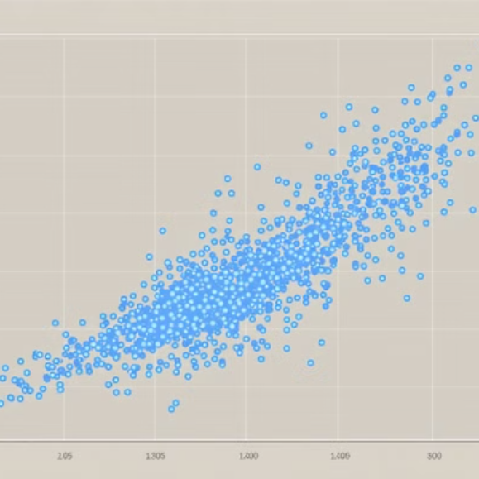
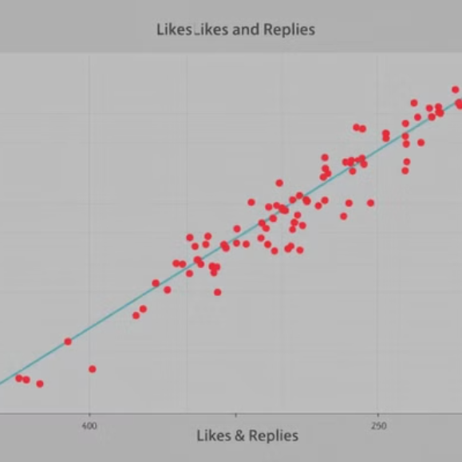
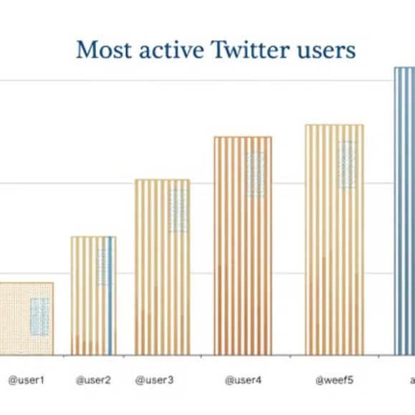
User Engagement Analysis
Understanding user engagement is crucial for evaluating content performance on Twitter. The code demonstrates several approaches to analyzing engagement metrics, including scatter plots comparing likes vs. retweets and likes vs. replies, as well as bar charts identifying the most active users.
These visualizations help identify relationships between different engagement metrics and reveal which users are driving the conversation. For example, a strong correlation between likes and retweets might indicate content that resonates well with the audience, while highly active users might be influential voices worth monitoring or engaging with.
By combining these various analysis techniques, you can gain comprehensive insights into Twitter data that inform social media strategy, market research, or academic studies of online communication.

